Slide 1
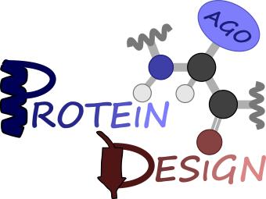




Computational design of dimeric de novo heme-binding helical bundle proteins
Institute of Biochemistry, Technical University of Graz, Austria
Veronica Delsoglio*, Gustav Oberdorfer
Graduate Seminar II
07.04.2021
ERC (European Research Council) funded project

Slide 2
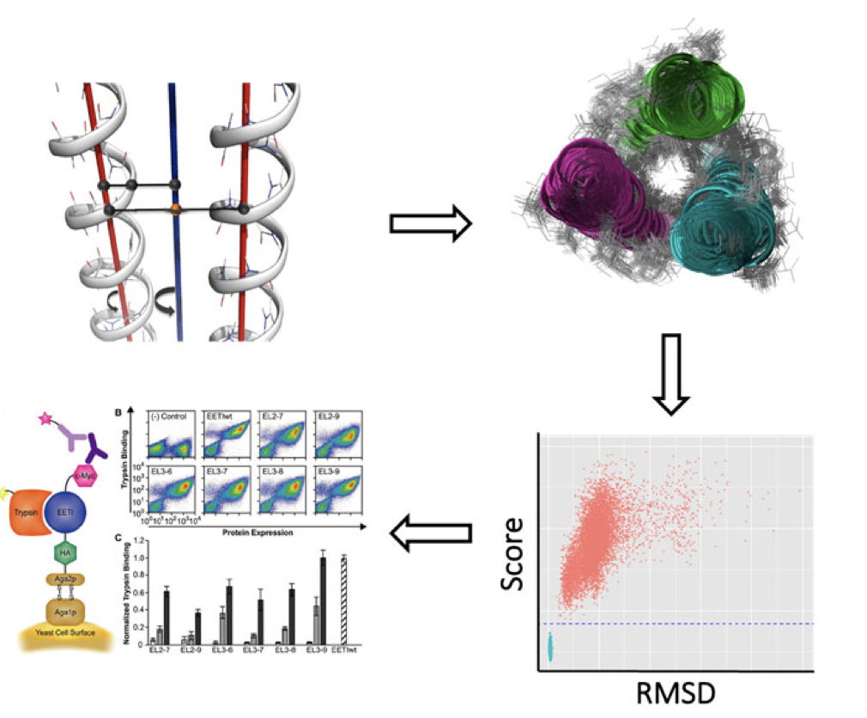

Main theme of the project
De novo protein design
Modelling and energetical optimization of the structure
Wetlab:
protien production
biochemical caracterization
Folding prediction
- RT Fold
- AlphaFold2

Slide 3

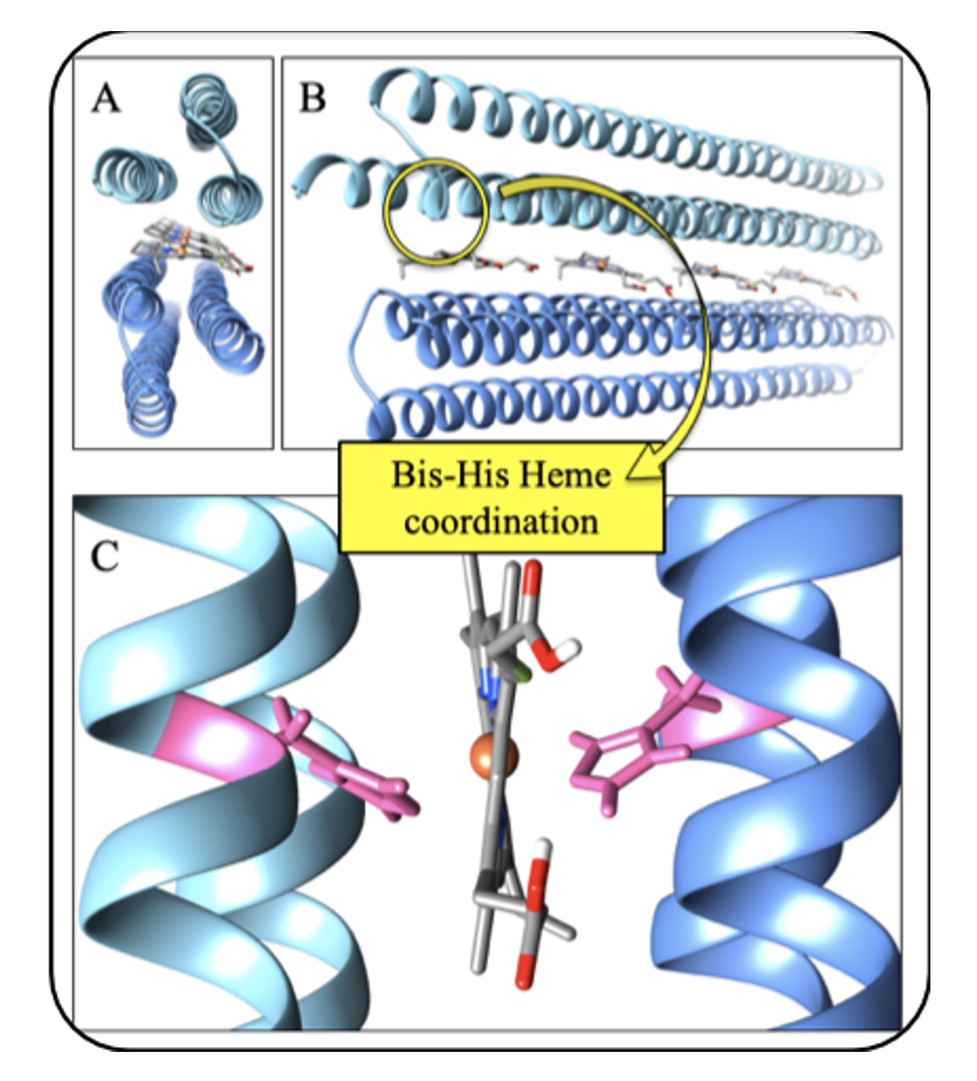
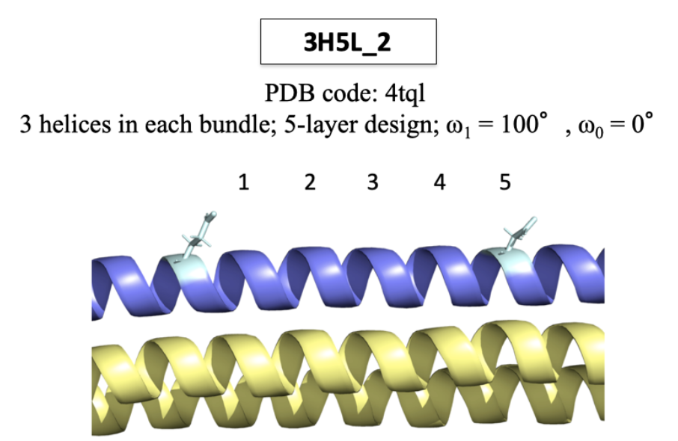
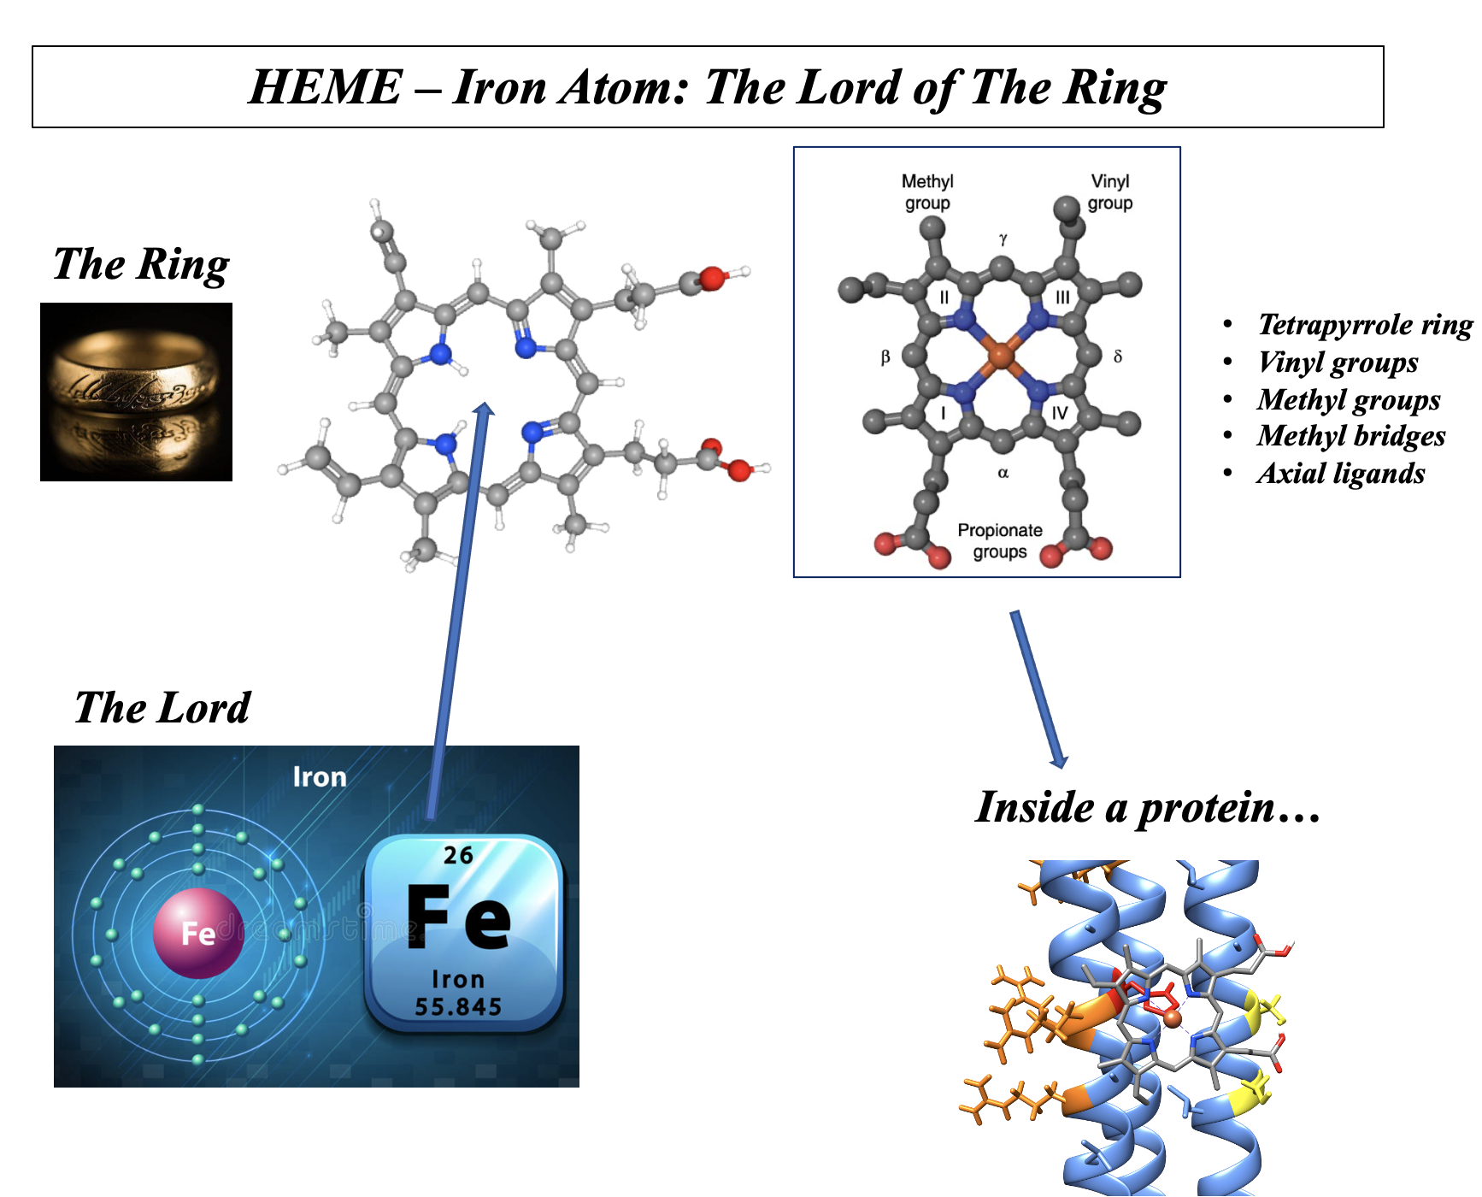
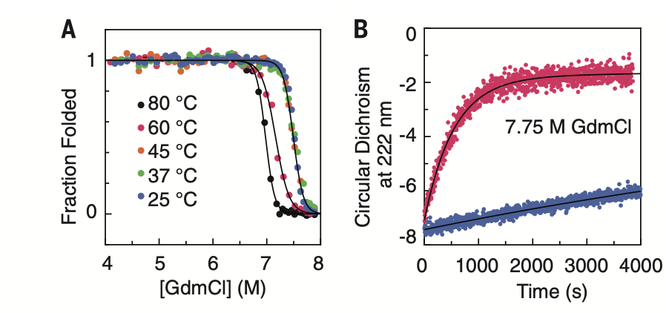
Project Overview
MORE COMPLICATED SYSTEM
Asymmetric ligand bounding a symmetric protein scaffold;
Electron transfert;
Built the 3H5L scaffold using parametric design

Slide 4
Project Overview
In silico design and modelling
Bundle truncation
Sequence design
Symmetrization
Heme incorporation
Starting idea
Ab initio prediction
Energies evaluation
Wetlab
Protein expression and production
Biochemical characterization

Slide 5
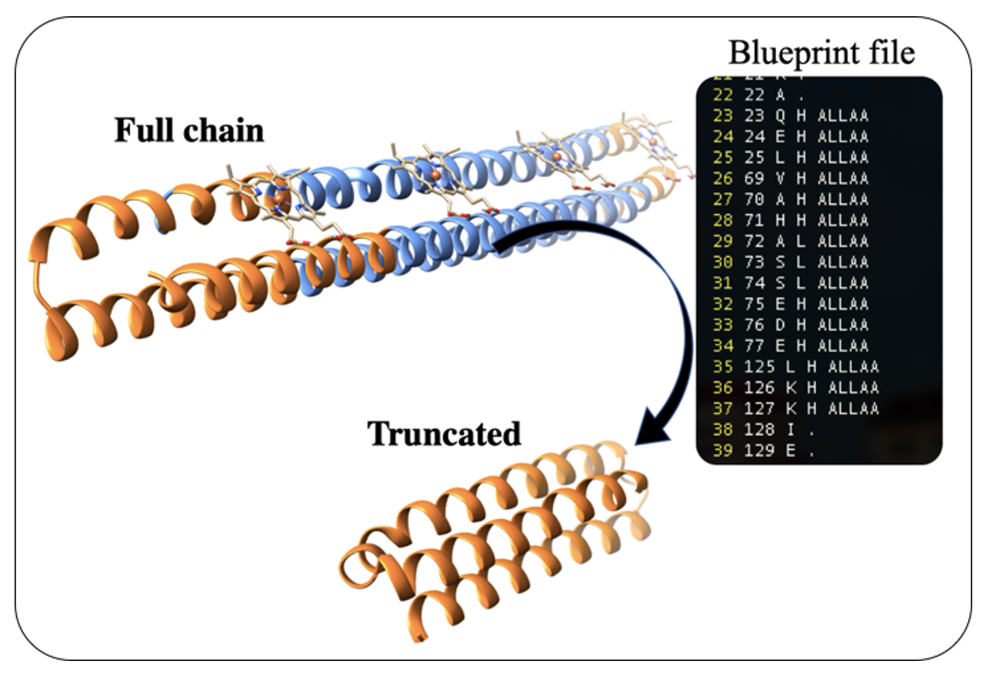
Results
In silico design and modelling
Bundle truncation
Sequence design
Symmetrization
Heme incorporation
Remodel application in Rosetta;
Blueprint file;

Slide 6
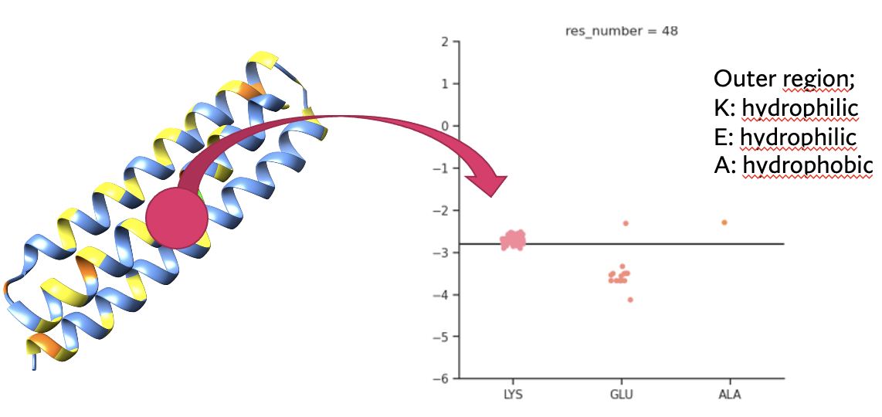
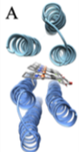
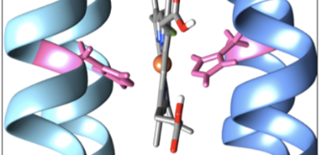
Results
In silico design and modelling
Bundle truncation
Sequence design
Symmetrization
Heme incorporation
xml script: Layer Design mover (SEQUENCE DESIGN-LAYER);
xml script on lcluster: PackRotamer mover (SEQUENCE DESIGN-REU);
Python script: REU evaluation at each residue position;
Remodel application;

Slide 7
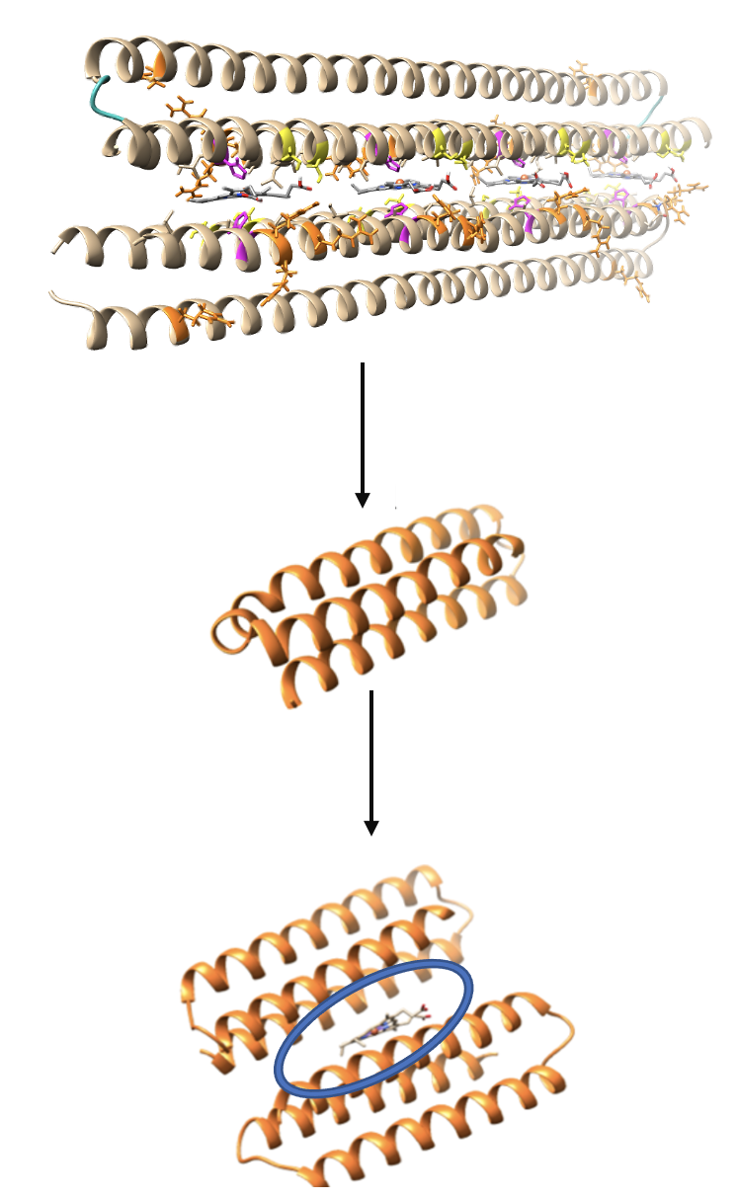
Results
In silico design and modelling
Bundle truncation
Sequence design
Symmetrization
Heme incorporation
xml script: Symmetry mover;

Slide 8
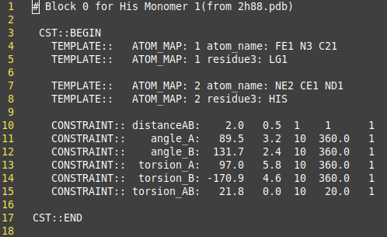
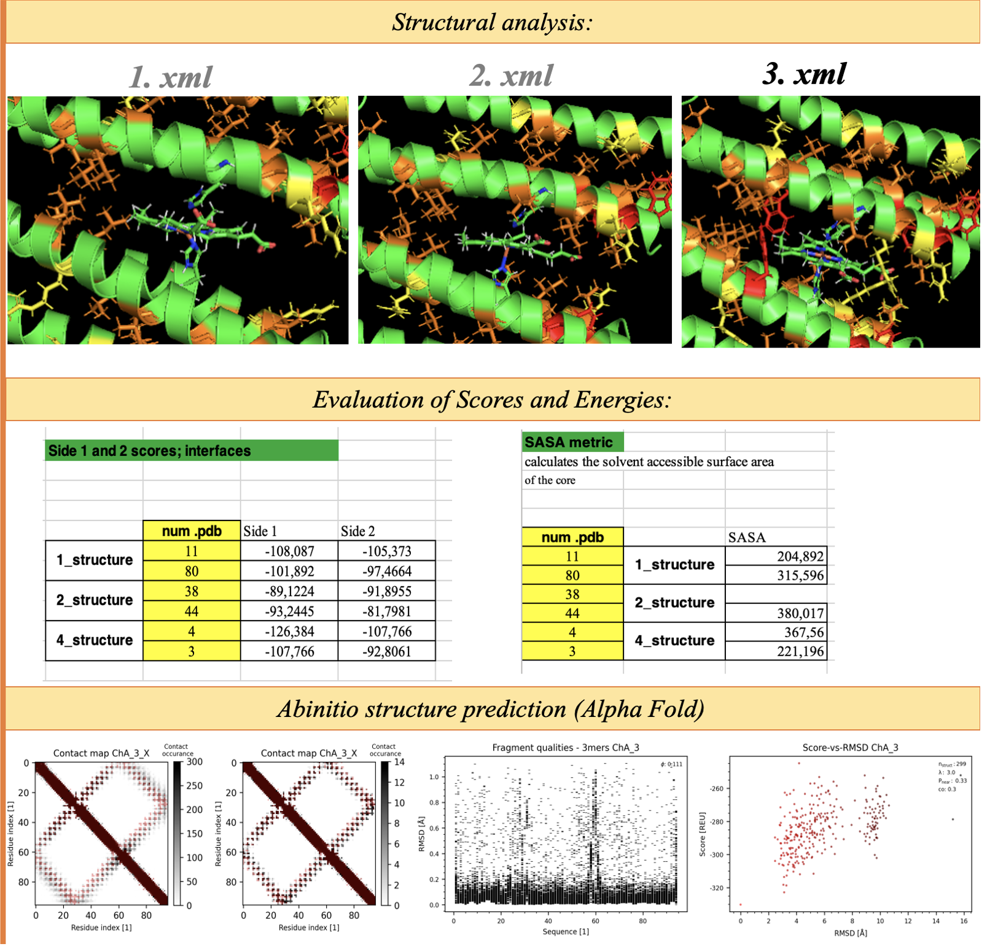
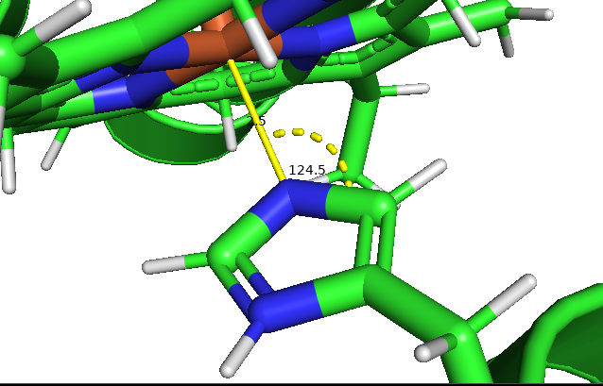
Results
In silico design and modelling
Bundle truncation
Sequence design
Symmetrization
Heme incorporation
Constraint file;
Matching application;
Binding pocket optimization (xml script);
Abintio prediction (RT Fold, AlphaFold2);
HEME
HIS

Slide 9
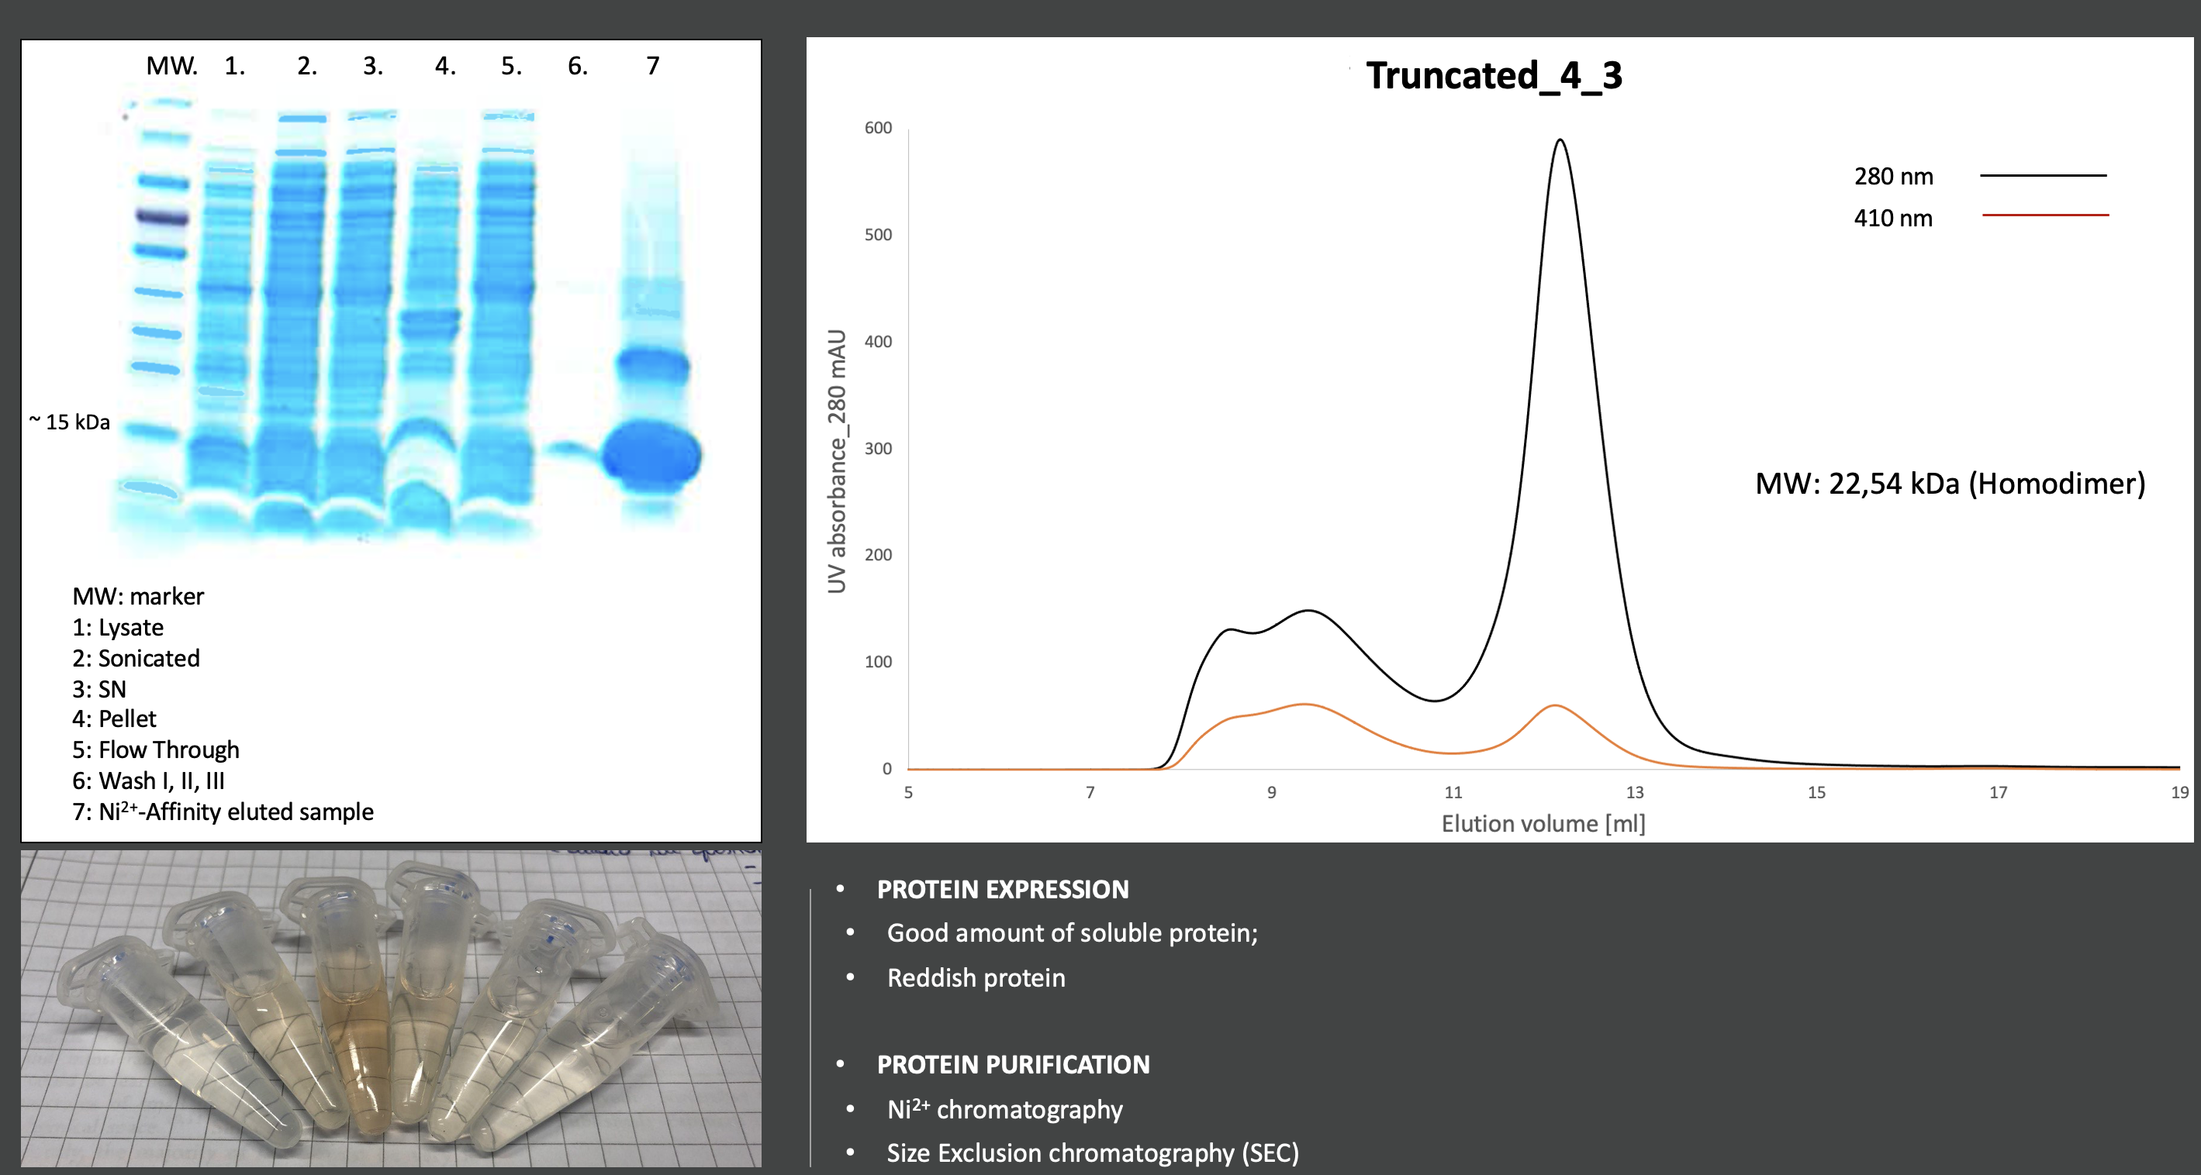
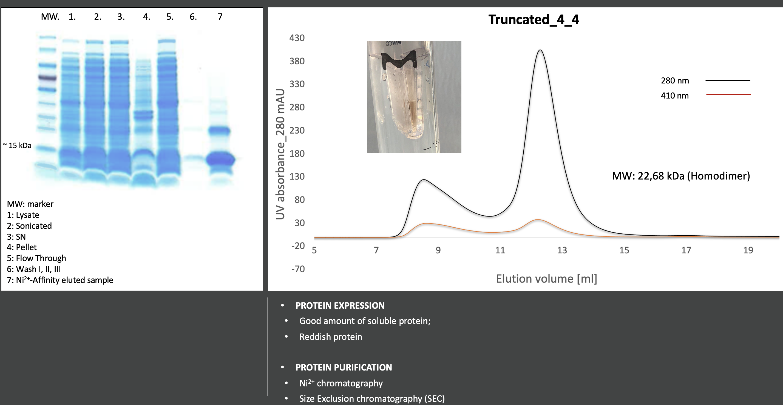
Results
Wetlab
Protein expression and production
Biochemical characterization
E.coli BL21-STAR competent cells transformation;
Cell growth (2L TB broth) ;
d-ALA Heme precursor;
Protein production O.N. induction at 18 °C (1mM IPTG);
Ni ²⁺ affinity chromatography;
SEC chromatography (FPLC);

Slide 10
Results
Wetlab
Protein expression and production
Biochemical characterization
Structural characterization: Homodimer
Heme inclusion inside the dimer (bis-HIS coordination)
Circular Dichroism;
Thermoscan measurements (CD device);
SAXS;
Crystallography;
UV/vis spectroscopy;
Mass Spectroscopy;
mutants
MS
xstals new optimization

Slide 11
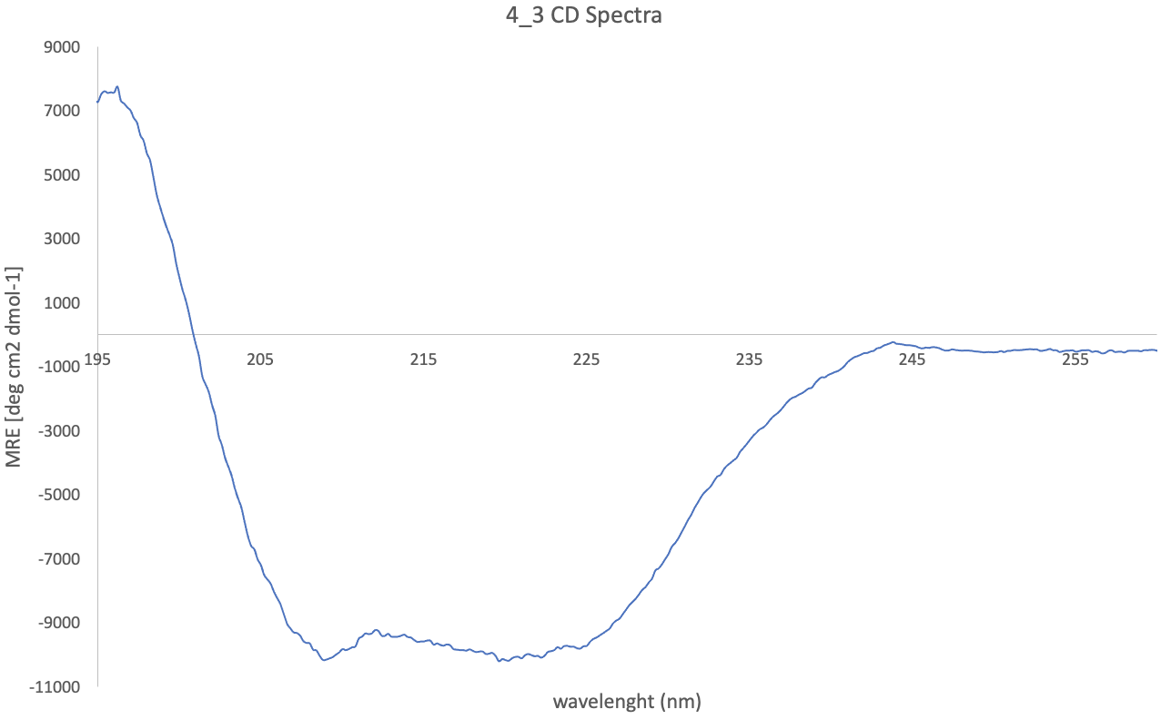
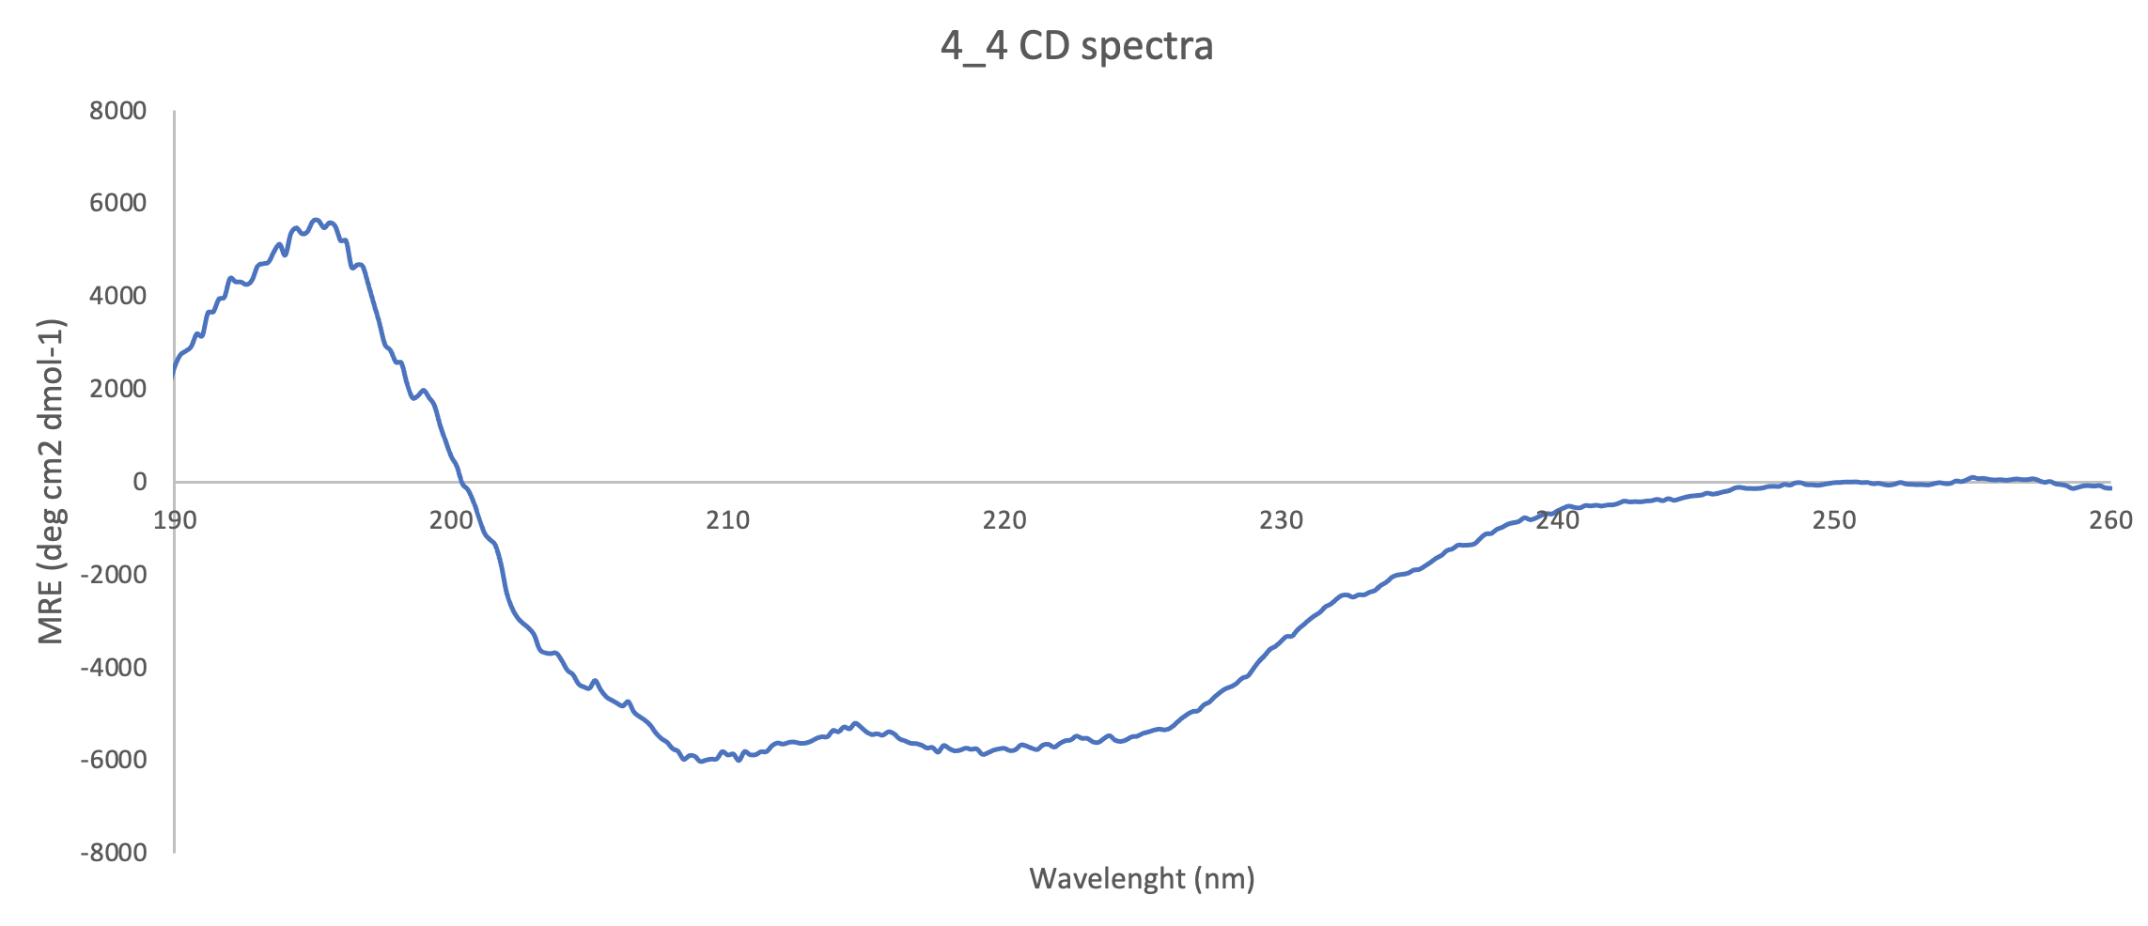
Results
Wetlab
Protein expression and production
Biochemical characterization
Structural characterization
Circular Dichroism;
Thermoscan measurements (CD device);
SAXS;
Crystallography;
Alpha-helical bundles;

Slide 12
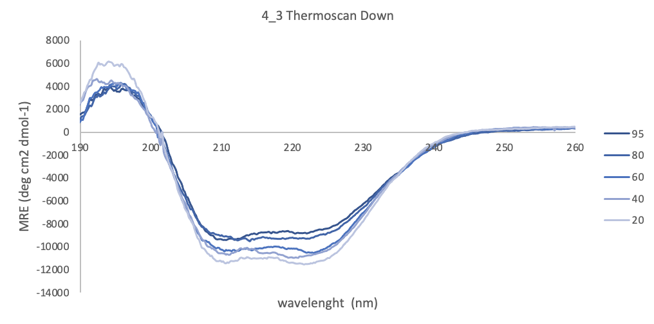
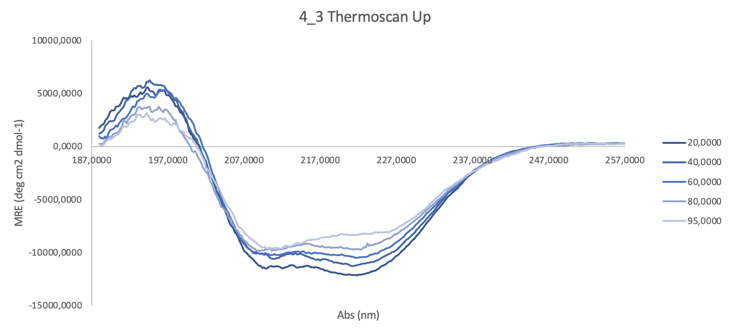
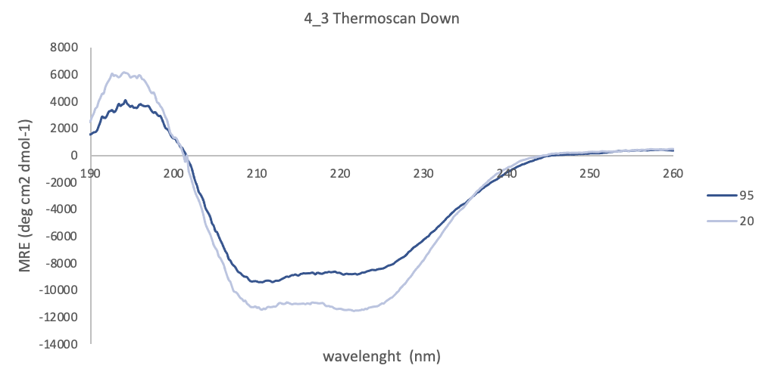
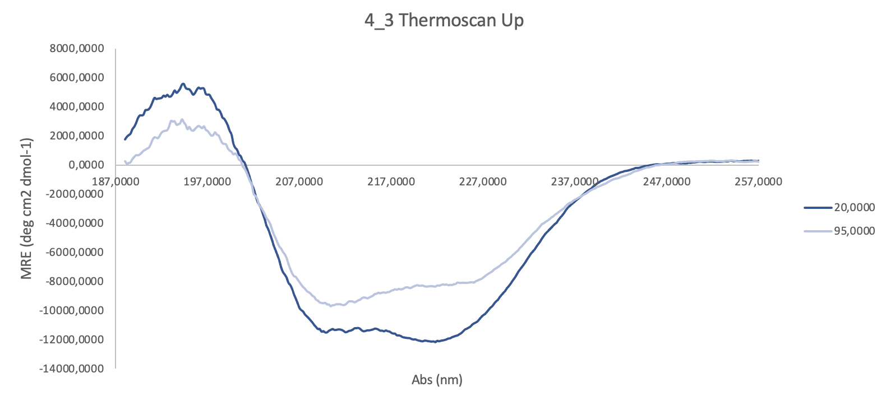
Results
Wetlab
Protein expression and production
Biochemical characterization
Structural characterization
Circular Dichroism;
Thermoscan measurements (CD device);
SAXS;
Crystallography;
wavelenght (nm)
2) Thermostable structure;
wavelenght (nm)

Slide 13
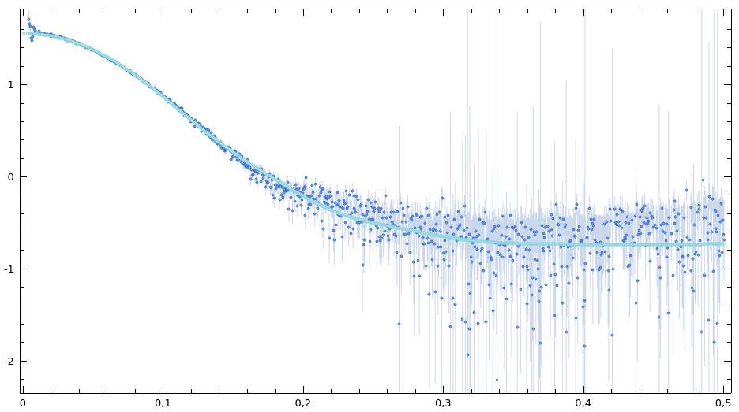
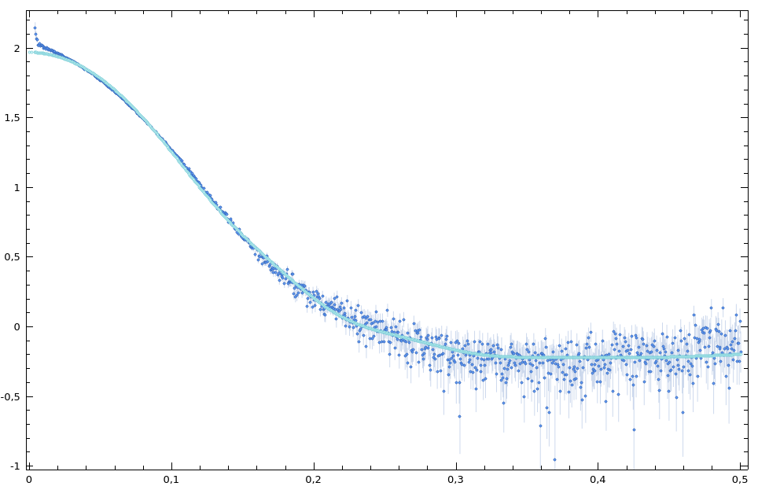
Results
Wetlab
Protein expression and production
Biochemical characterization
sample
fit
Structural characterization
4_3
C: 4.76 g/l
X²: 6.04
logI
Circular Dichroism;
Thermoscan measurements (CD device);
SAXS;
Crystallography;
q[Å⁻¹]
ATSAS: Primus
background subtraction
number of points: 51
number spherical points: 50
Model structure: with HisTag and Heme
sample
fit
3) Homodimeric shape;
logI
4_3
C: 2.0 g/l
X² : 1.35
q[Å⁻¹]

Slide 14
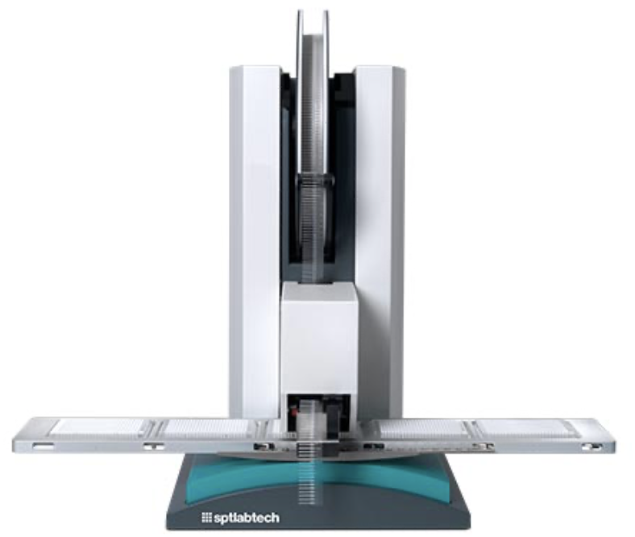

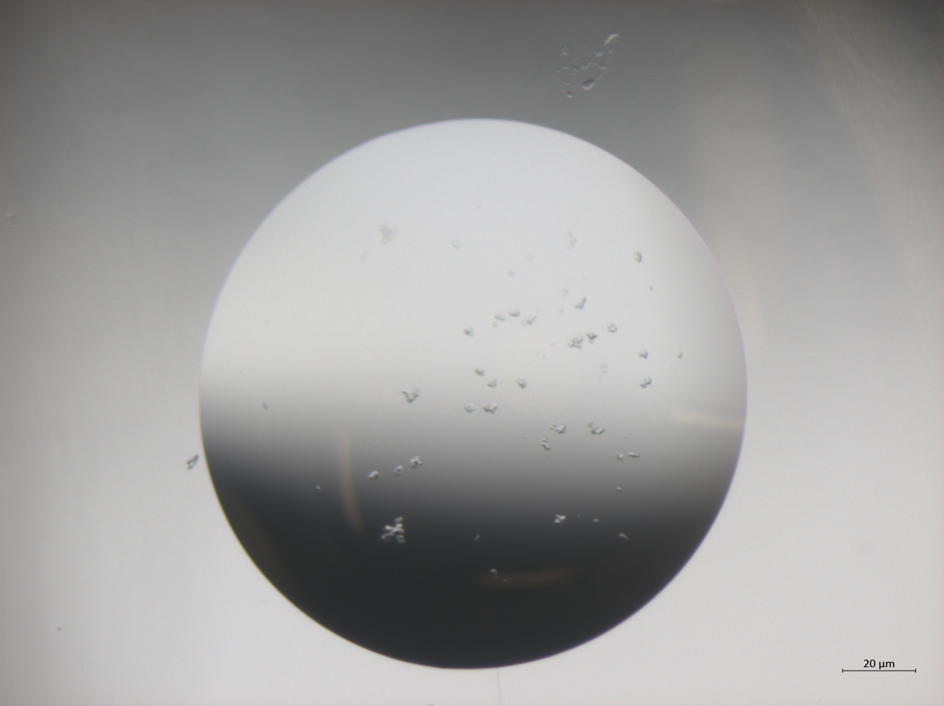
Results
Wetlab
Mosquito Crystallography Robot
Protein expression and production
Biochemical characterization
Structural characterization
Circular Dichroism;
Thermoscan measurements (CD device);
SAXS;
Crystallography;
Screening process
Protein C: (15-20) mg/ml
Ratio Protein: Reservoir = 1:1 and 2:1
4) Work of screening still in progress;

Slide 15
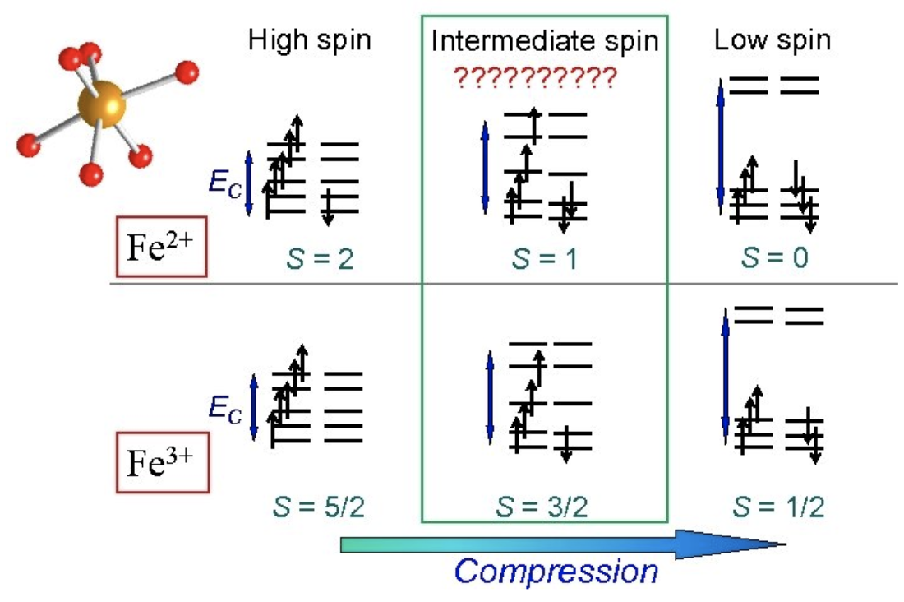
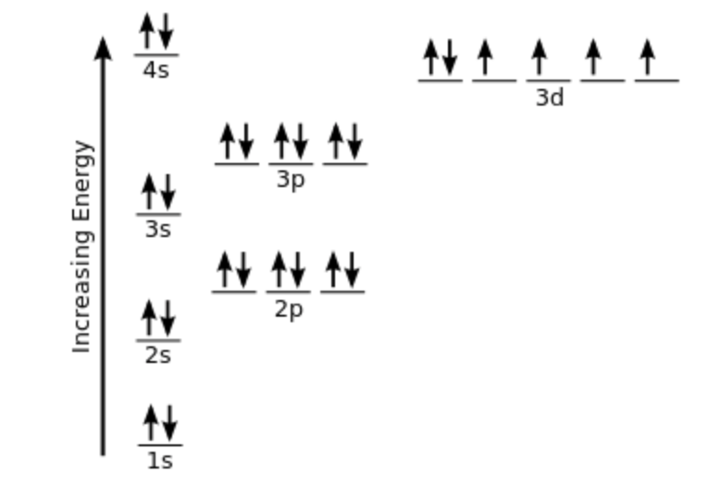
Results
Wetlab
Protein expression and production
Biochemical characterization
Heme inclusion inside the dimer
Fe electron configuration
Fe^{III} ls
https://socratic.org/questions/what-is-the-electron-configuration-of-iron
https://socratic.org/questions/what-is-the-electron-configuration-of-iron

Slide 16
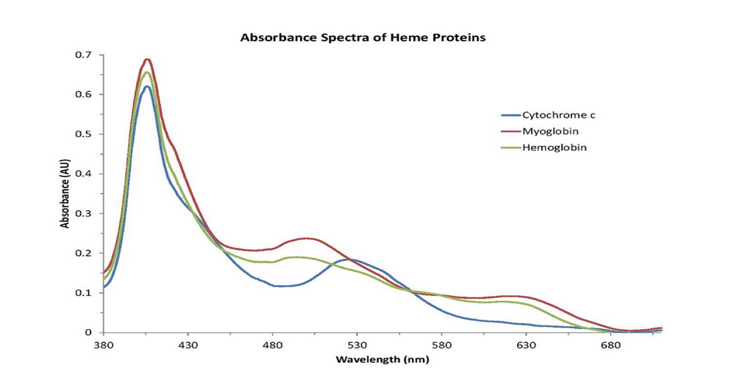
Results
Wetlab
Protein expression and production
Biochemical characterization
Soret Peak
B band
Heme inclusion inside the dimer
UV/vis spectroscopy;
Mass Spectroscopy;
Soret Peaks
Q bands
Generally around (400 – 420) nm;
The precise value depends on the protein whose the heme is coordinated with;
Extinction coefficient of the Heme can be different;
https://www.oceaninsight.com/blog/characterization-of-heme-proteins/

Slide 17
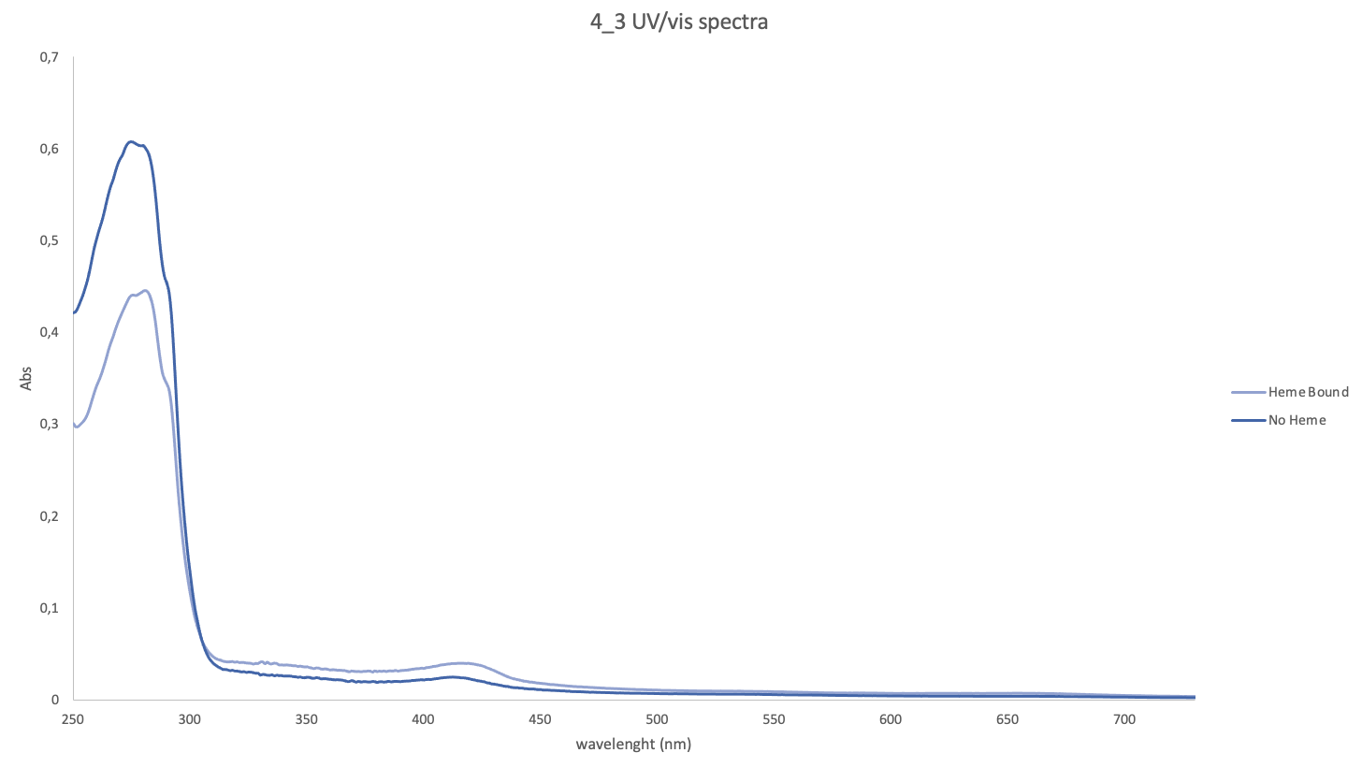
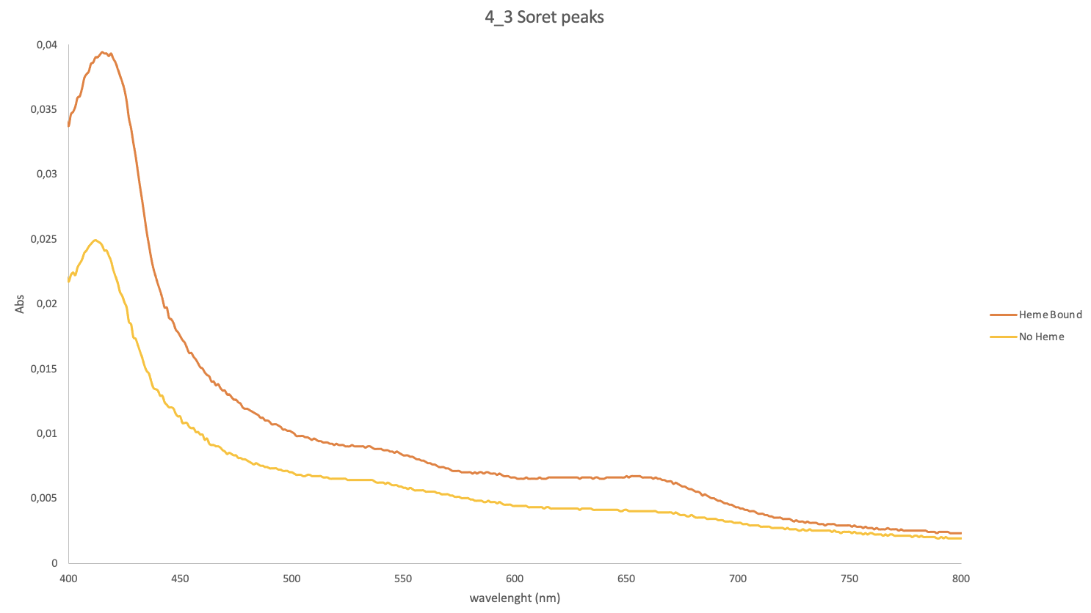
Results
Wetlab
Protein expression and production
Biochemical characterization
420 nm ; (530 -560) nm; (650 -700) nm
Heme inclusion inside the dimer
UV/vis spectroscopy;
Mass Spectroscopy;
Comparison:
Protein with Heme induction
Protein without Heme induction
5) Soret peak stronger for Heme-inducted protein;

Slide 18
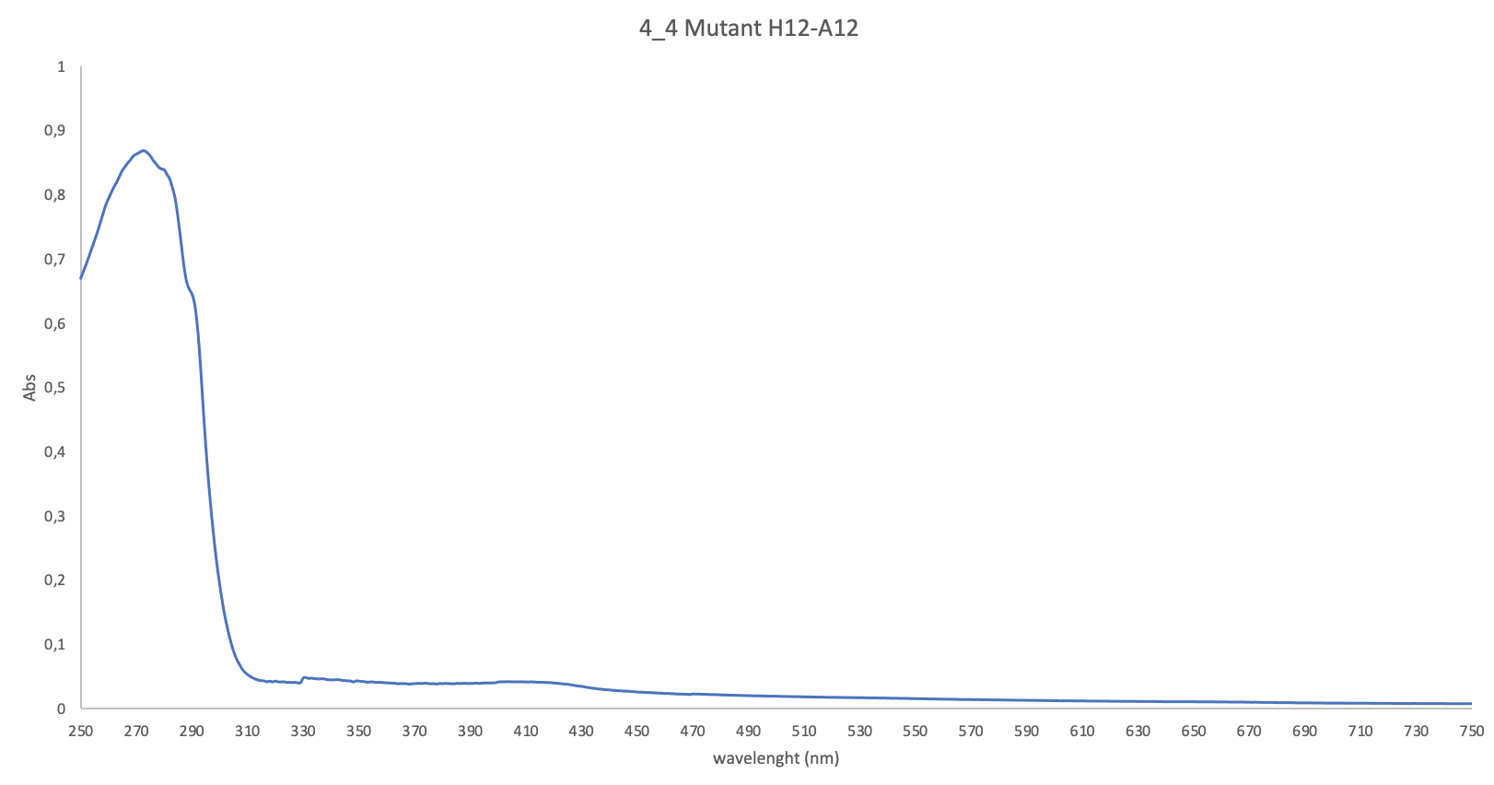
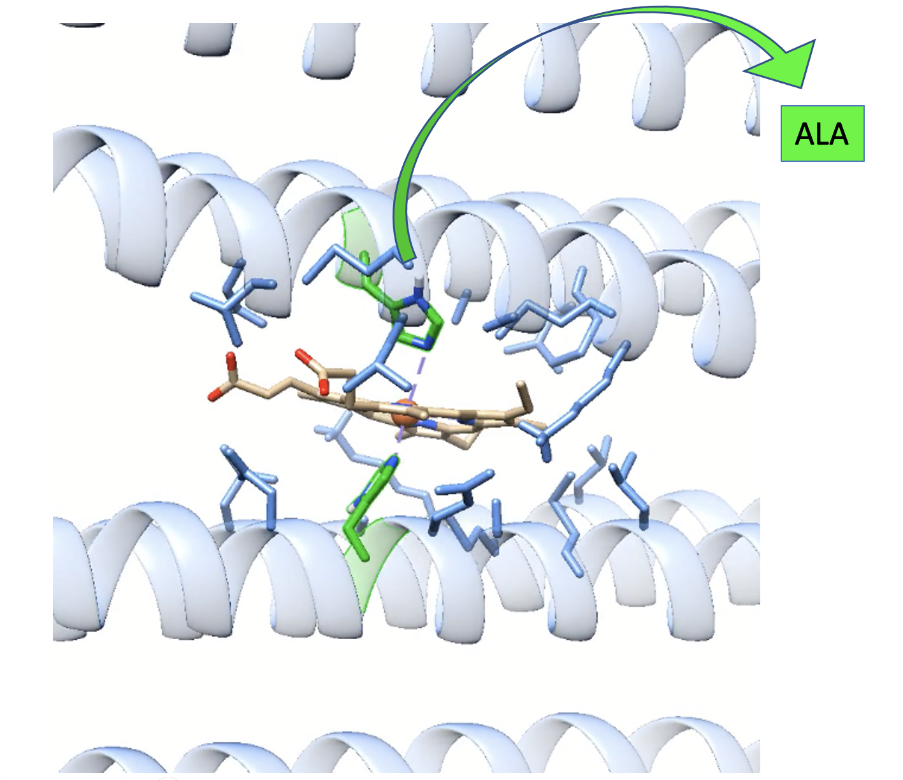
Results
Wetlab
Protein expression and production
Biochemical characterization
420 nm
Heme inclusion inside the dimer
UV/vis spectroscopy;
Mass Spectroscopy;
HIS 12 mutated into ALA. Does the coordination with the Heme still persist ?
6) Soret peak stronger for H12 protein. Binding Pocket relevant for Heme binding;

Slide 19
Results
Wetlab
Protein expression and production
Biochemical characterization
Heme inclusion inside the dimer
UV/vis spectroscopy;
Mass Spectroscopy;
7) ALWAYS:
When used d-ALA the heme quantity bounded in the B.P. is higher;
The heme quantity bounding the B.P. is less is the Mutant protein form than in the original one;

Slide 20
Conclusions and Future perspectives
Truncated bundle:
Alpha- helical bundles;
Homodimeric shape formed;
Soret peak stronger for Heme-induced proteins;
Soret peak weaker for H12A proteins (both BP and HIS important for Heme inclusion);
→ Homodimeric structure binding the heme
Future works:
Crystallographic structure;
Detection of the Heme with Fe^{III} ls state once it is bis-HIS coordinated: MS, NMR, MPE
Works in progress:
Crystallographic structure;
Mutations of other residues in the BP to decrease the eventual coordination with side chains groups of the b-type Heme;

Slide 21
Aknowledgements

